Slide 1
Project BR04D$W0RD
Capstone Final

Slide 2
The Problem
The Alfred State E-Sports Team needs a reliable way for coaches to be able to schedule practices for their teams.
They currently have a system where they write practice times on a whiteboard, but this solution has caused issues such as coaches double booking times and times accidentally getting erased.

Slide 3
Our Solution
We propose a simple reservation application that can create and display bookable times for the coaches to train their specific team for upcoming tournaments.
The application will have a booking view set on a web application that will work as the create/read/update/delete reservations.
The made reservation will then display the booked times on a large television set in their gaming space.

Slide 4
Benefit of our application
Our application eliminates the need for the white board and the issues surrounding it.
The coaches of all teams will be the administrators of this application on a single sign-on account to make things more convenient.
Since coaches are the only ones that can book practicing times, it ensures that individuals that are not part of a team can't reserve a time when a team does.

Slide 5
Needs assessment
Needs:
Create/Read/Update/Delete reservations for team practice times
Display reserved times on television set, every 2 weeks shown (Current week and the next)
Single-sign on account for Coaches
Wants:
Accessibility from mobile devices
Abide by proper HCI principles
Potential animations to make the interface turn heads

Slide 6
PEST - Political
SUNY has regulations for software created within the SUNY system.
Alfred State has regulations for student created software.

Slide 7
PEST - Economic
This project will receive no development funding.
Per regulations, this software will need to be free.

Slide 8
PEST - Social
Alfred State is mostly made up of students aged 17-25 years of age (although there is a higher amount of non-traditional students outside of this age range than another school), teachers, and staff members.
The students at Alfred State have diverse backgrounds and majors of study.
The teachers at Alfred State have diverse background, ages, and areas of study.
There is not much to do in the way of entertainment in the area, so many people turn to clubs, sports, or Greek life on campus.
There are renovations going on throughout campus that are displacing clubs and organizations.

Slide 9
PEST - Technological
Although there are exceptions, many students will access applications on their mobile devices. and many teachers will access applications on their personal computers.
Throughout all of Alfred State’s campus, internet connectivity is available.

Slide 10
SWOT
Strengths:
We are motivated to get a good grade on this project.
Several members of our group have good relationships with members of the E-Sports Team.
Weaknesses:
We have limited time and resources.
Team
Opportunities:
The major up-and-coming group is Alfred State E-Sports and they are well supported by the school.
We have peers and faculty members that we can contact for advice or assistance.
Threats:
Alfred State Event Management System is a competitor.
SUNY and Alfred State regulations could possibly stop the use of the application.

Slide 11
Tools Used
Languages:
PHP
XML
Database Packages:
MySQL
Other Tools Used:
GitHub
SharePoint

Slide 12
Security
The Alfred State E-Sports room already has card swipe access where only the executive board members have access.
We will provide the credentials for the login to the coaches and it will be their responsibility to keep the credentials within the coaches.
Since there is only one role that the software needs to be operated under, there will only be one set of credentials that will be shared by the coaches.
We will also need to ensure validation and sanitization of the inputs in the form that users will be filling out to book times.

Slide 13
ERD
Reservations
ID
GroupTime
ReserverDate
StartTime
EndTime
Color

Slide 14
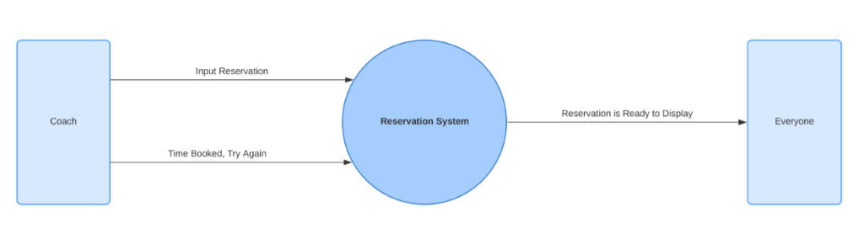
DFD

Slide 15
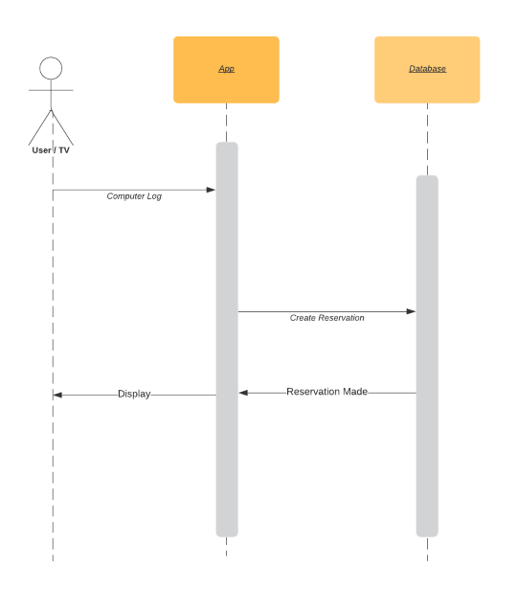
Sequence Diagram

Slide 16
Application Demonstration

